Slide 1
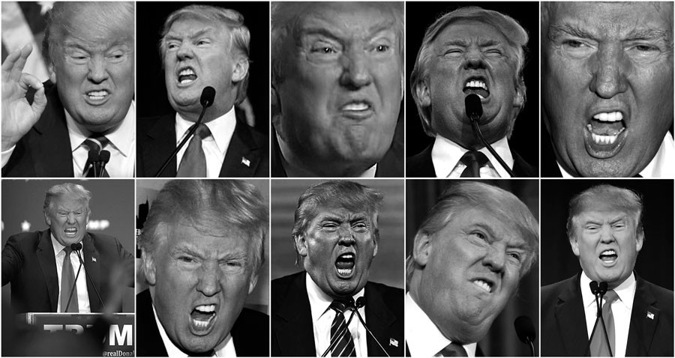
Facial Expression Recognition
Group 1
>>>>>>-Feng Su
>>>>>>-Sitong Liu
>>>>>>-Tiancheng Wang
>>>>>>-Hui Chiang
>>>>>>-David Zhang
Notes:
本PPT模板部分元素使用了幻灯片母版制作。如果需要修改，点击-视图-幻灯片母版-修改；完成后关闭编辑母版即可。

Slide 2
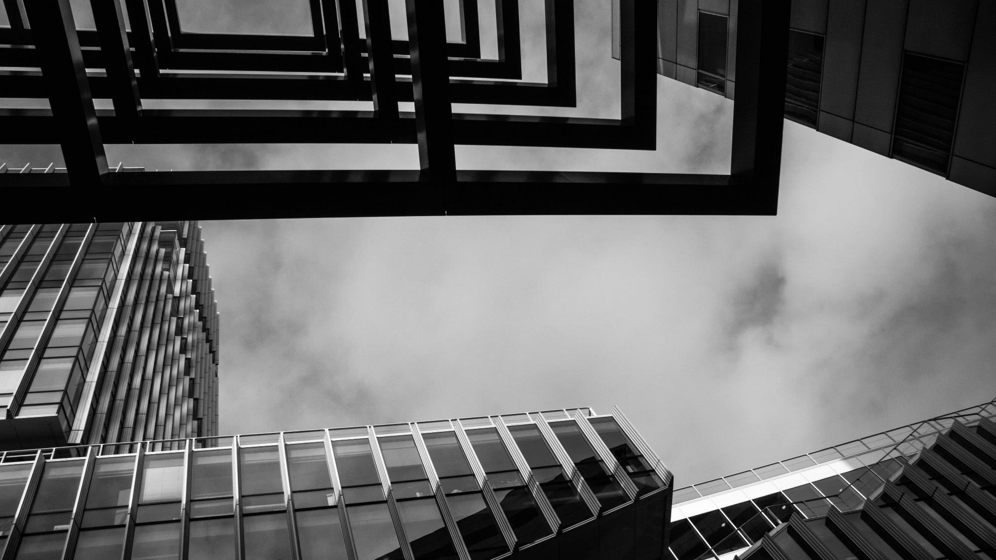
CONTENTS
Motivation
Models
implments
Conclusion
What can you learn
from this project
A brief introduction to CNN
The implementations
of CNN models
In this project
Some more Interesting areas worth exploring

Slide 3
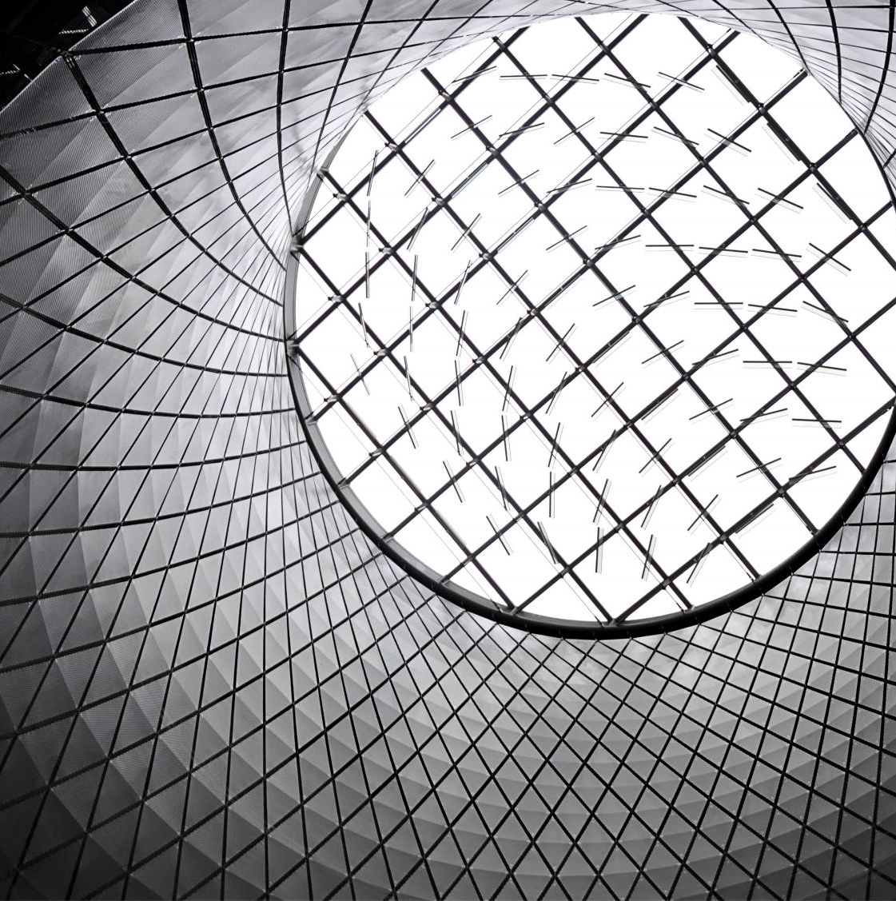
Motivations
A facial recognition model which can be applied to many fields
A basic understanding towards CNN
ready

Slide 4


CNN Model
‘’Convolutional neural networks are deep artificial neural networks that are used primarily to classify images (e.g. name what they see), cluster them by similarity (photo search), and perform object recognition within scenes‘’
Convolution Layer
Pooling Layer
Full Connection Layer

Slide 5

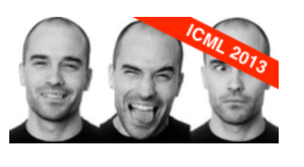
Dataset
“The data consists of 48x48 pixel grayscale images of faces. The faces have been automatically registered so that the face is more or less centered and occupies about the same amount of space in each image. The task is to categorize each face based on the emotion shown in the facial expression in to one of seven categories (0=Angry, 1=Disgust, 2=Fear, 3=Happy, 4=Sad, 5=Surprise, 6=Neutral).
train.csv contains two columns, "emotion" and "pixels". The "emotion" column contains a numeric code ranging from 0 to 6, inclusive, for the emotion that is present in the image. The training set consists of 28,709 examples. The public test set used for the leaderboard consists of 3,589 examples. The final test set, which was used to determine the winner of the competition, consists of another 3,589 examples”.

Slide 6

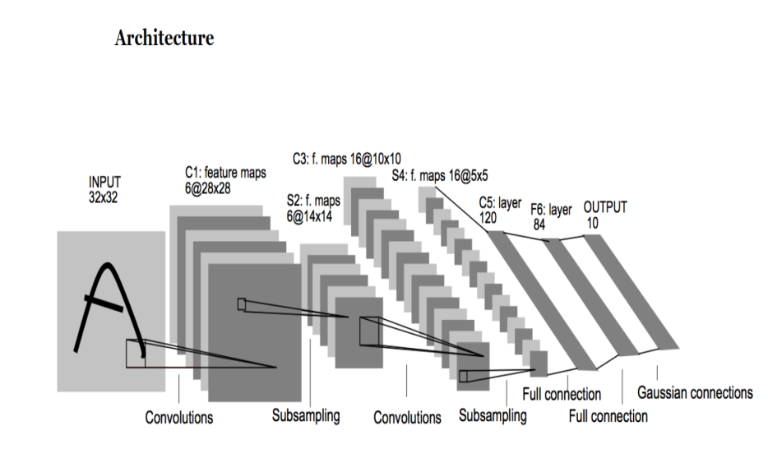
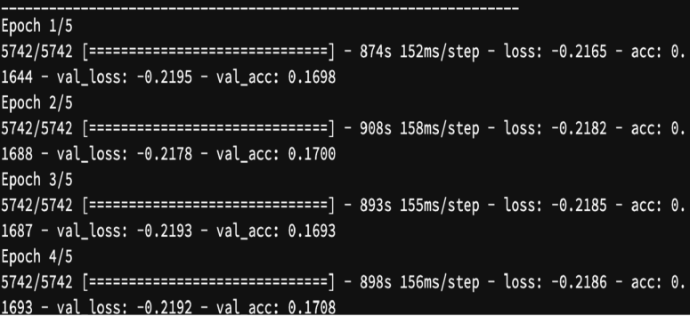
LeNet-5
“Yann Lecun‘s LeNet-5 model was developed in 1998 to identify handwritten digits for zip code recognition in the postal service. This pioneering model largely introduced the convolutional neural network as we know it today”

Slide 7

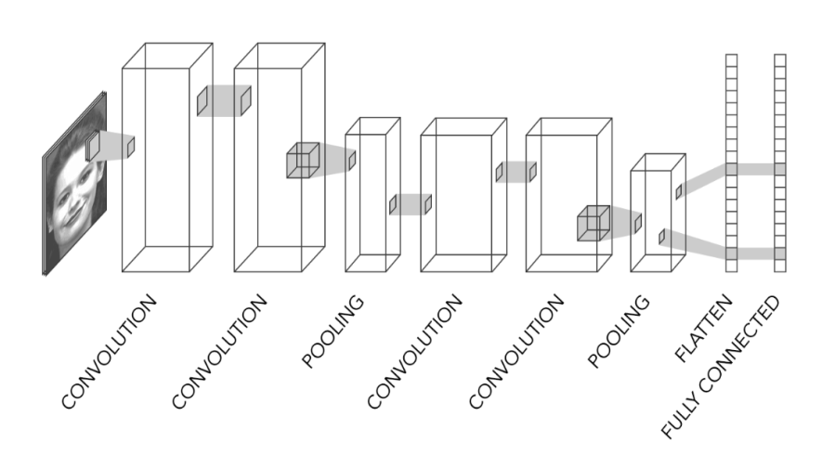
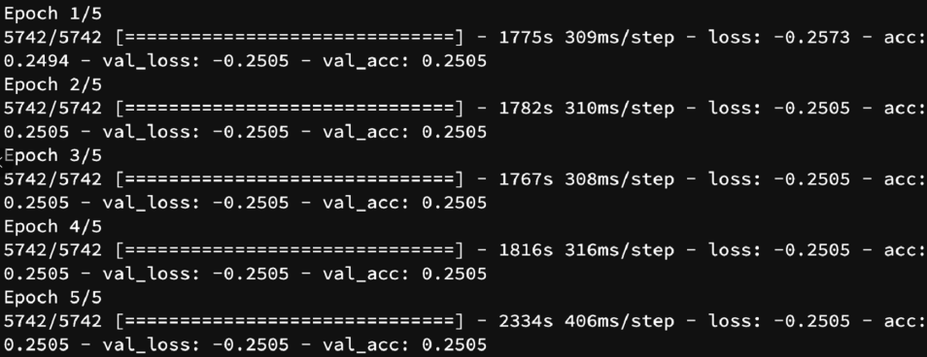
What we have tried to improve the baseline model

Slide 8

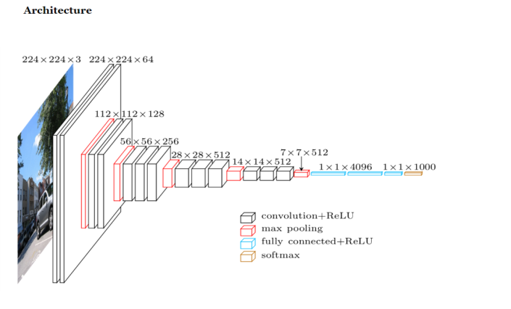
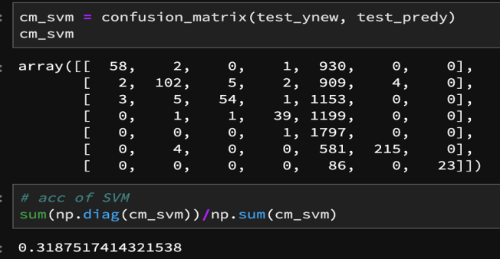
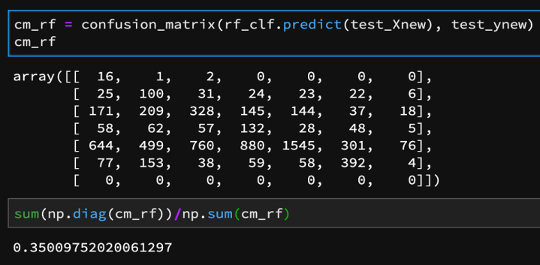
Pre-training model with SVM/RF

Slide 9
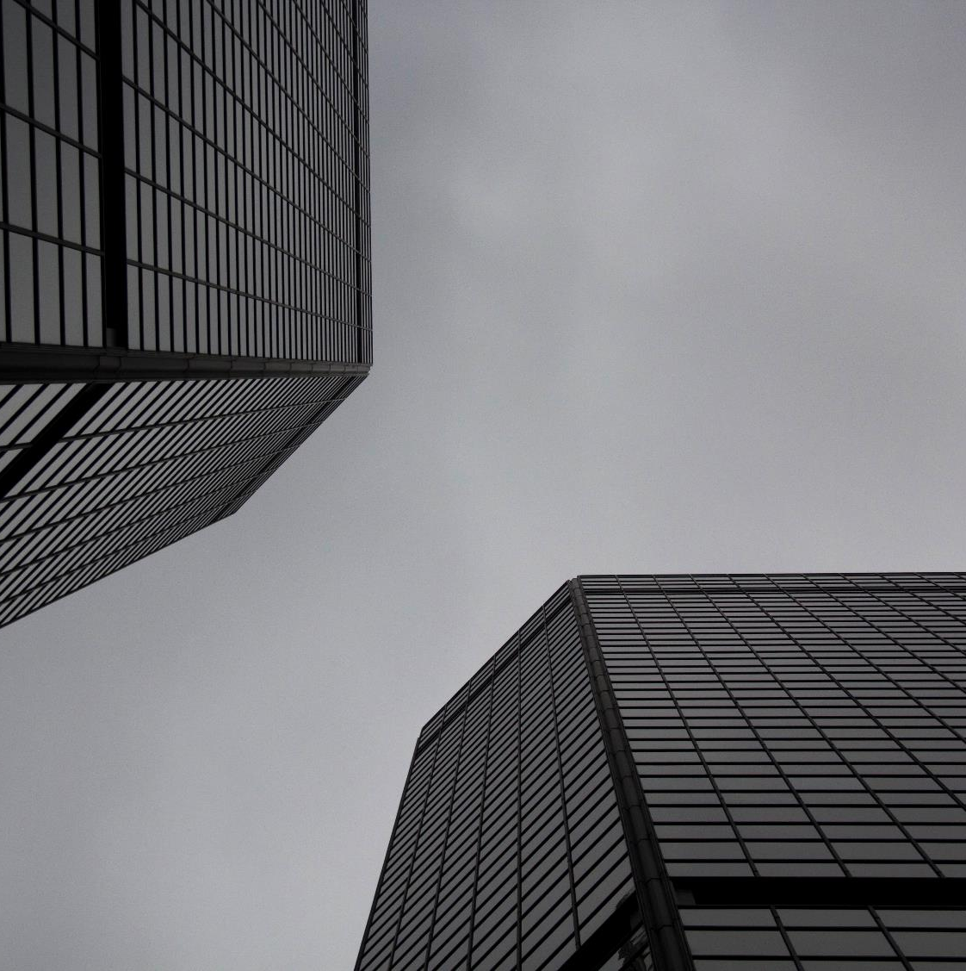
Conclusion
Different combination of layers and parameter values
More advanced models, such as AlexNet and Inception(GoogLeNET)

Slide 10
Thanks for your attention!
Notes:
本PPT模板部分元素使用了幻灯片母版制作。如果需要修改，点击-视图-幻灯片母版-修改；完成后关闭编辑母版即可。

